Slide 1
South East Asian Study Group Meeting in Industrial Problems
Transients in congested traffic
Matti Heilio
Lappeenranta University of Technology
Finland

Slide 2
Mixture Traffic In Crowded Urban City
Situation: a mixture of several types of vehicles, like motorbikes/three-wheelers and cars, buses, trucks
The traffic-character of each vehicle category is different, for instance there is a huge swarm of motorbikes that are flowing amidst the passenger cars using arbitrary routes, zig-zagging across lanes, packing/unpacking in temporary parallel strings etc.

Slide 3
Mixture Traffic In Crowded Urban City
The ability of the bike swarm to accelerate/decelerate is large etc. This kind of traffic is especially interesting on road section with traffic lights, where the queue-formation and take off after green light is an important transient event.
Generate novel(?)ideas about how to model such a traffic flow.

Slide 4
Simplification: Two Flows, Cars + Bikes
Flow /Intensity = Number Of Vehicles Passing A Cross-section
q_{i}=q_{i}(x,t)
Density/Concentration = Number Of Vehicles Per Unit Distance
k_{i}=k_{i}(x,t), i=1,2 (Cars, Bikes)
Speed Depending On Congestion/Density

Slide 5
Simplification: Two Flows, Cars + Bikes
Road Capacity = Max-density= Kmax??
Friction Phenomenon = Speed Affected By Relative Traffic Load
K(x,t)/Kmax??
Two Different Flows Occupying Same Road??
Different Characteristics? One Flow Affecting The Other.

Slide 6
Illustration: Two Streams, Cars And A Stream Of Bikes

Slide 7
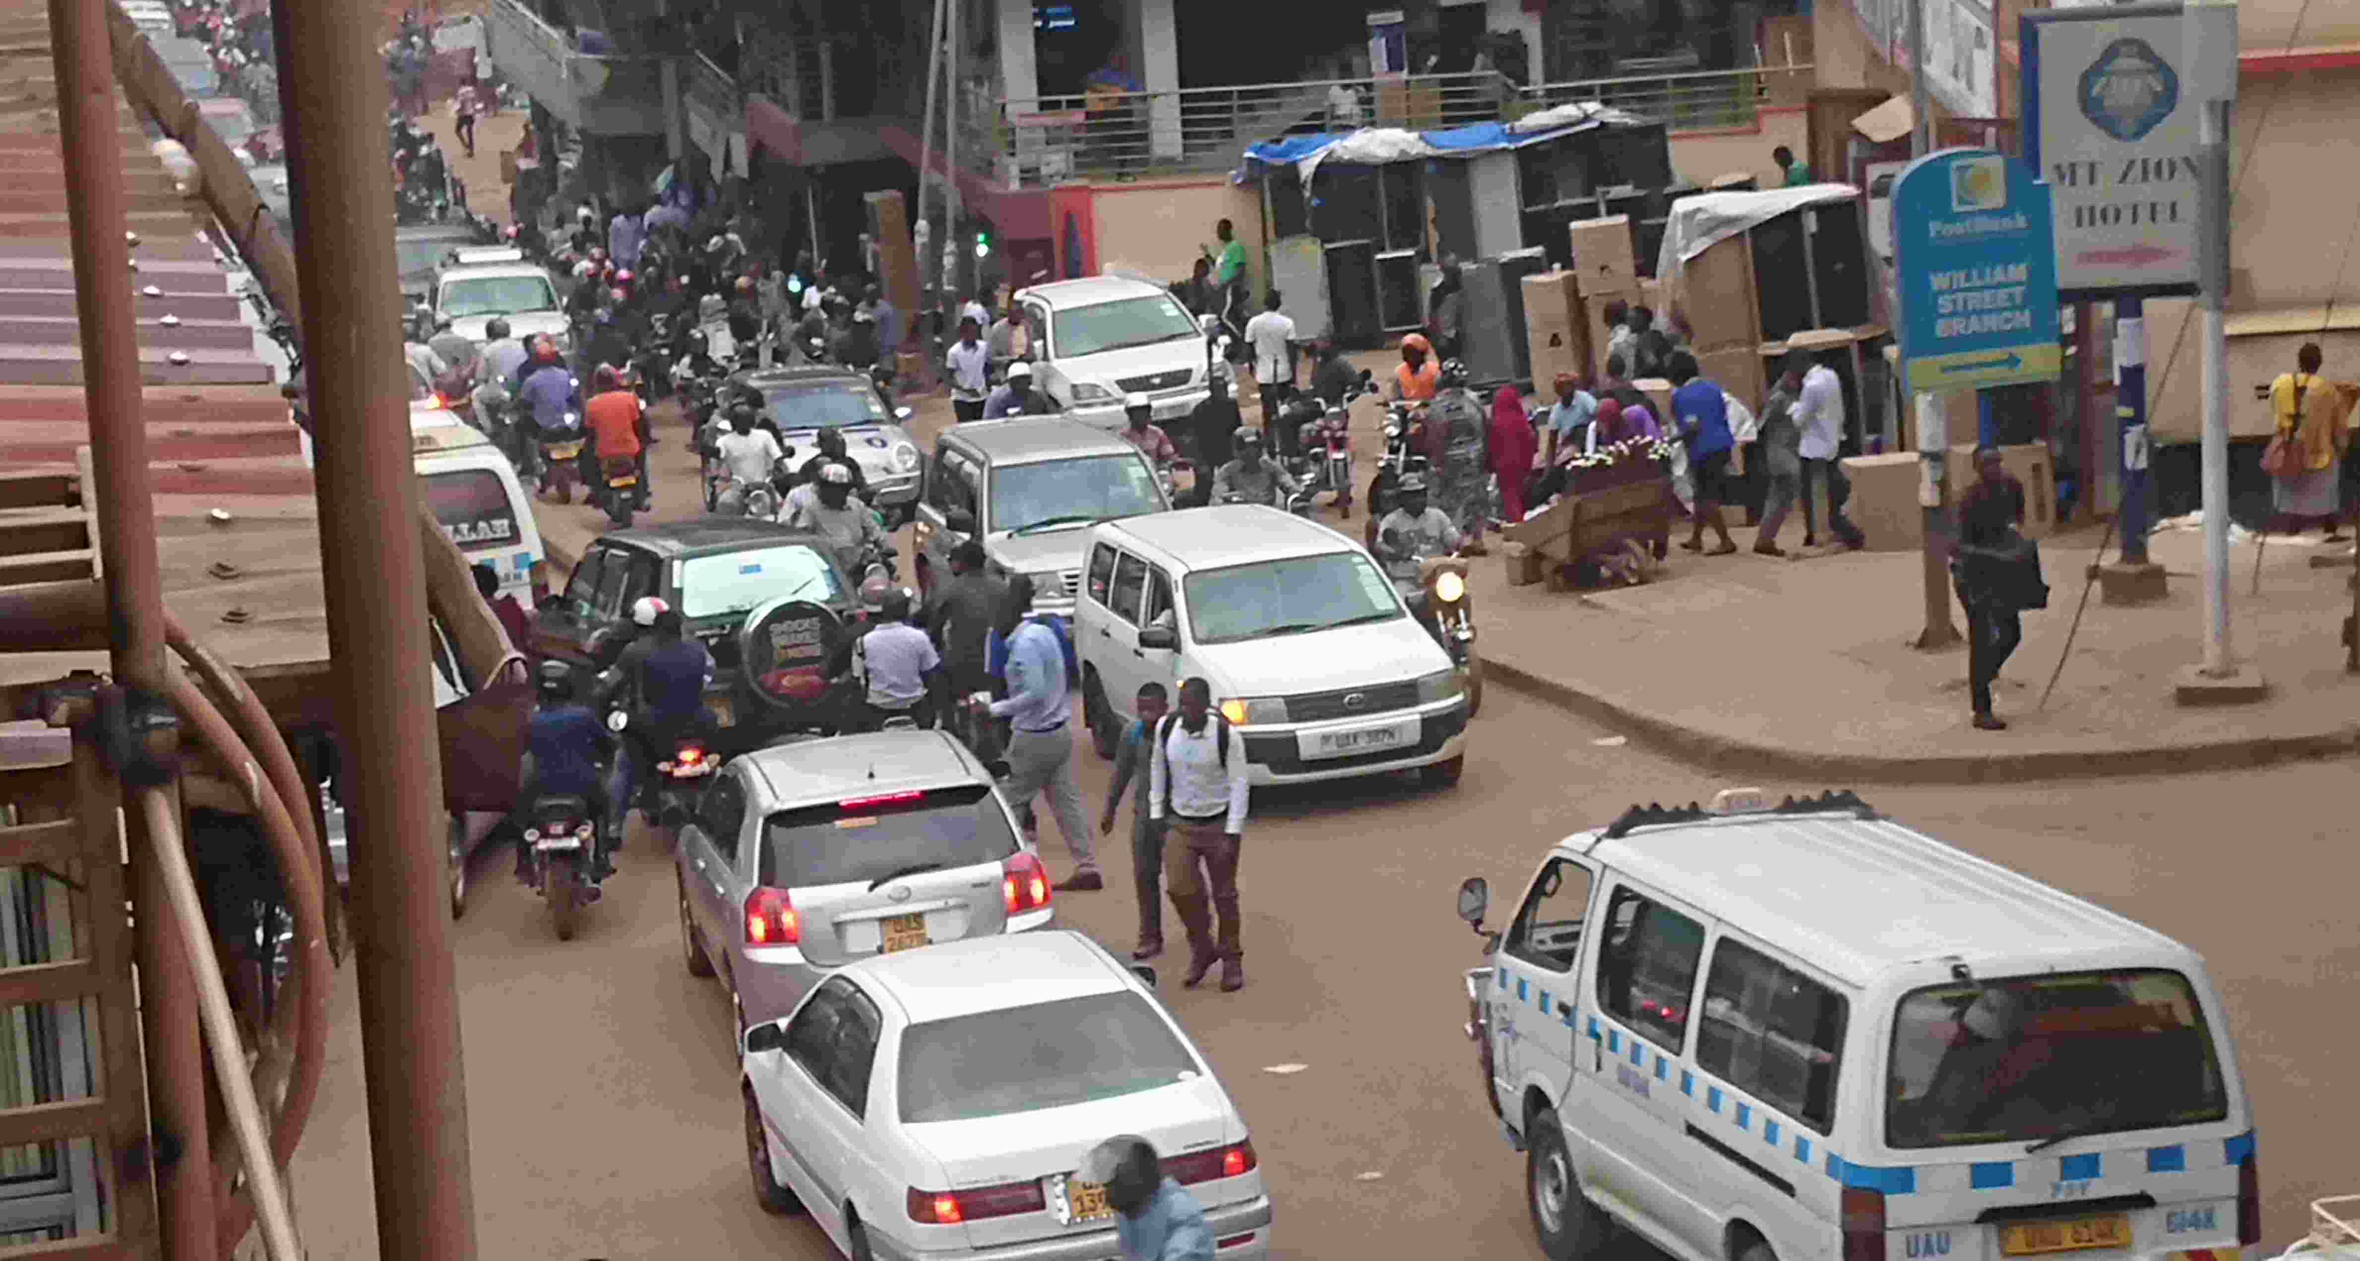
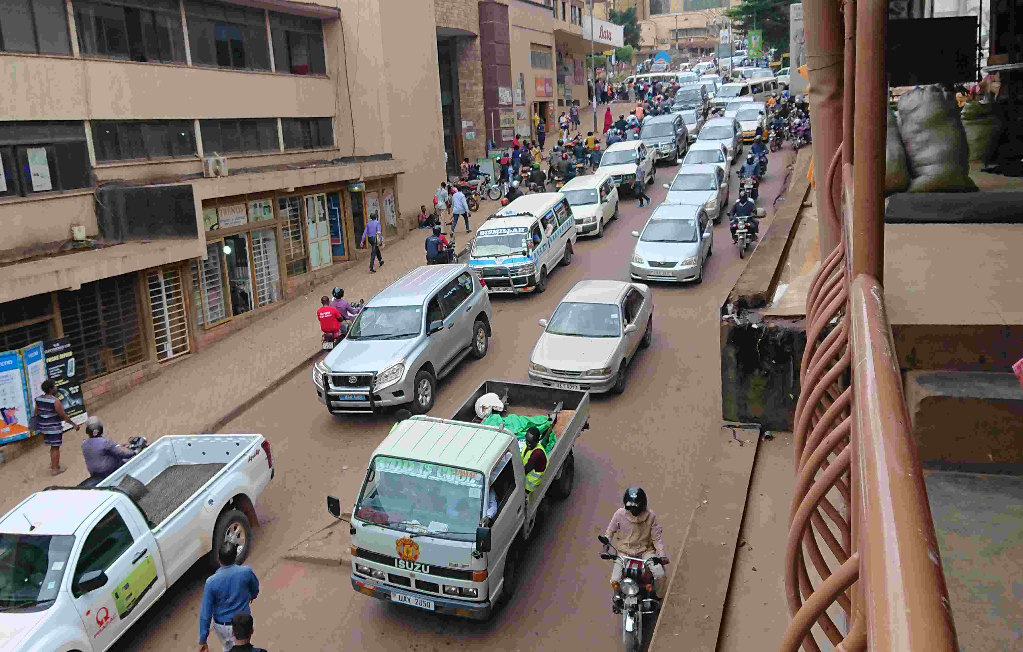
Imagine This Density And Congestion
Multiplied By 2 Or 3….

Slide 8


