Slide 1
Mr. Sudhir Nambiar
Adaptive Ocular Sciences Pvt. Ltd.
Chitra Gujarat Industrial Development Corporation, Bhavnagar, Gujarat, India
In-Situ Metrology of Medical Devices

Slide 2
Introduction to Company
Adaptive Ocular Sciences is a manufacturer of high end Intraocular Lenses at its state-of-the-art manufacturing unit based in Gujarat. AOS has a technical collaboration with Ocular Technology Inc - USA.
At AOS, we have made it our mission to manufacture next generation IOLs adhering to the highest global standards.
We have a dedicated and committed team having cumulative experience of more than 100 years in serving the ophthalmic industry. Dedicated R&D along with constant up-gradation of technologies and infrastructure ensures delivery of quality products.
Every single product that rolls out from our facility has our guarantee of world-class quality.

Slide 3
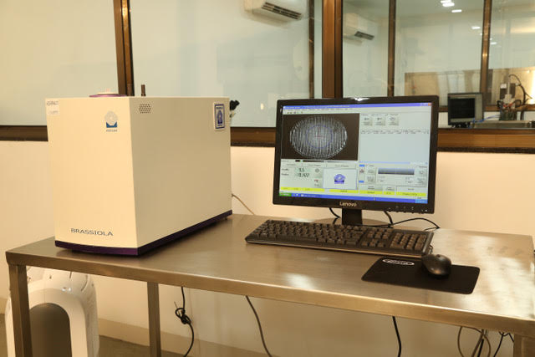
Introduction to Company

Slide 4
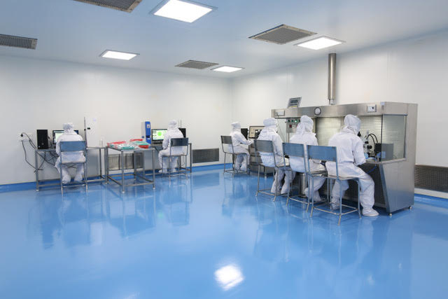
Introduction to Company

Slide 5
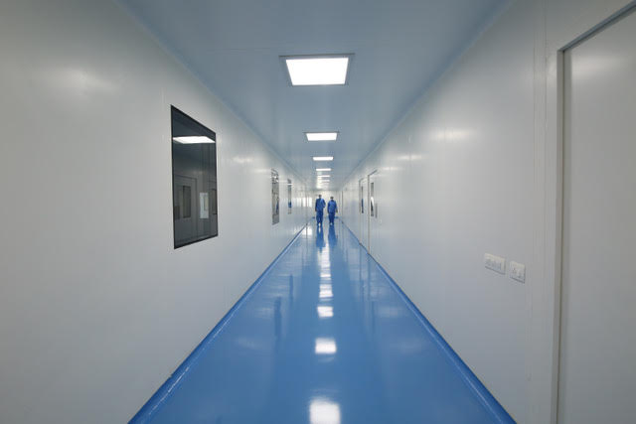
Introduction to Company

Slide 6
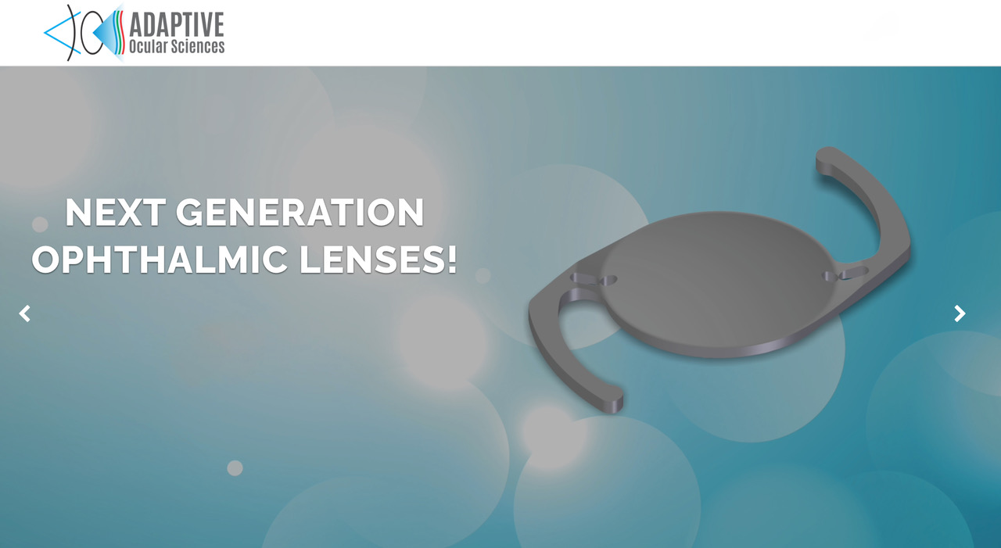

Slide 7
Introduction to Problem
Contact lenses and foldable Intra Ocular Lenses are medical devices that need to be machined in a DRY state (Single Point Diamond Turning of Hydrophilic Acrylics HEMA).
These are then hydrated in normal saline to make them soft. This process of hydration results in the dry parameters of the lens, like radius of curvature (power) and thickness of the lens getting altered due to the uptake of saline.
The swelling of the lens is dependent on multiple factors but mostly on the linear and radial expansion factor of the material being used.

Slide 8
Drawbcks:
The industry is faced with a challenge of measuring the dimensions of the lens namely its CT (Center Thickness).
ET (Edge Thickness) and Radius of Curvature in a liquid (saline) medium.
These lenses tend to dry out fast if taken out of saline thus altering their dimensions.
The soft nature of the lens is not conducive to contact measurements as this can result in wrong readings.

Slide 9
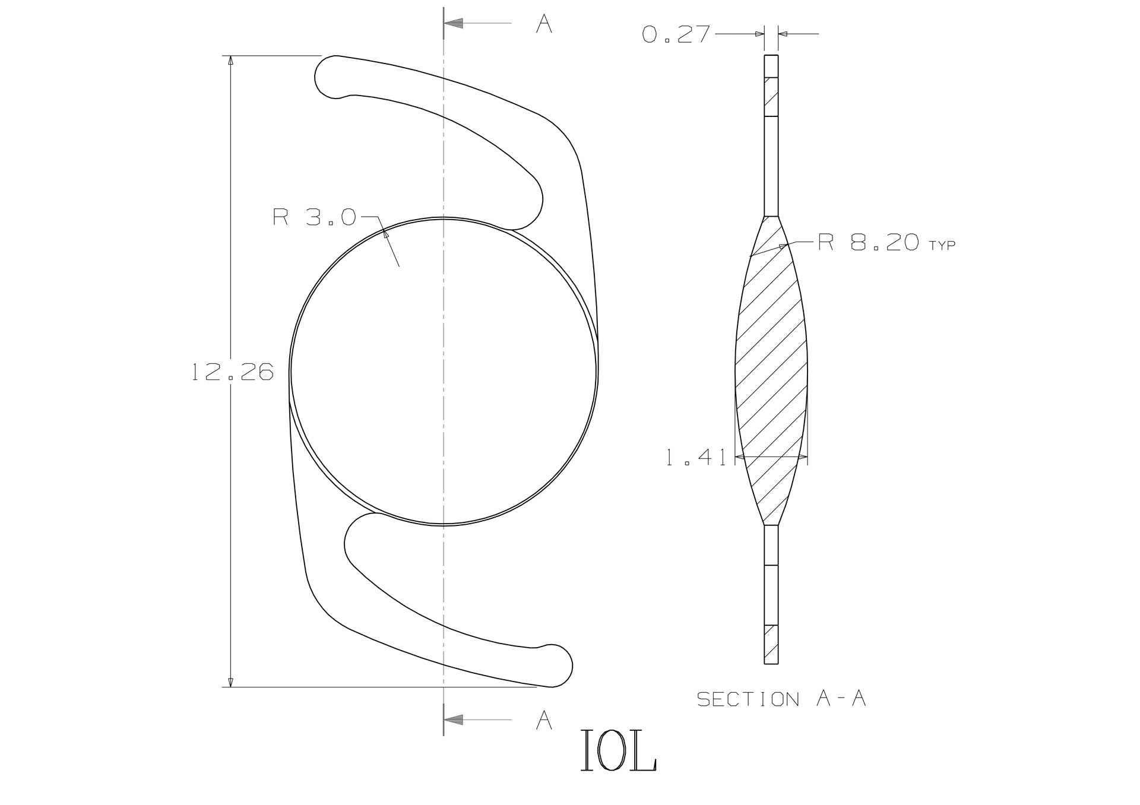

Slide 10
Contact Lenses

Slide 11
Objective of the Problem
A possible method that could be used to avoid these measurement difficulties is to develop an OCT system that can measure these parameters inside a saline medium like a cuvet / bath.
The resolution should be within a micron or two to make the measurement useful.
Measurement range is between 40 to 1500 microns. Area of interest is within 14mm.
Sag varies between the two medical devices. Contact lenses have a higher Sag compared to Intra Ocular Lenses.

Slide 12
Thank You

