Slide 1

Problem 05:
Gridded Climate Data for Local Scale
1st Virtual South East Asian Study Group Meeting on
Industrial Problems (VSEASGMIP 2020)
Dr. Sanskriti Mujumdar,
Director, Institute of Climate Change Research
Associate Professor, Civil Engineering Department, Faculty of Technology & Engineering
The Maharaja Sayajirao University of Baroda.

Slide 2
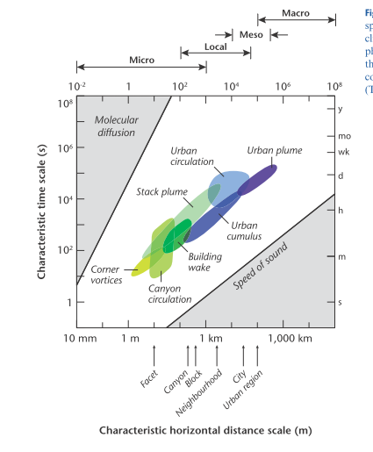
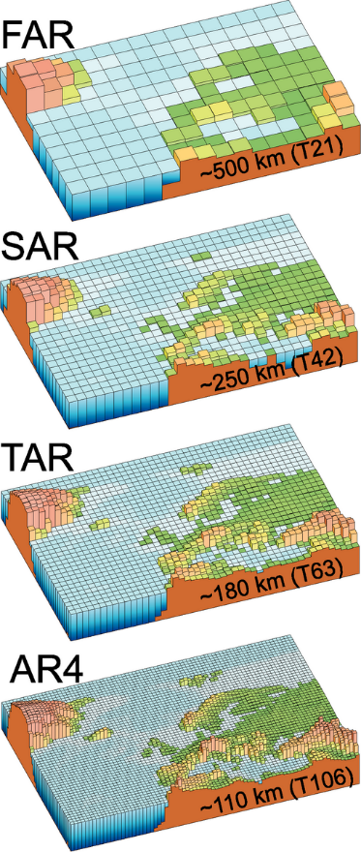
Objectives
How to preserve extreme values in methods of gridding and downscaling and interpolation.
How to enhance ‘performance’ (Through Re gridding at finer scale or through Down scaling) of Gridded datasets at local scale.
Notes:
AR = assessment reports of IPCC

Slide 3
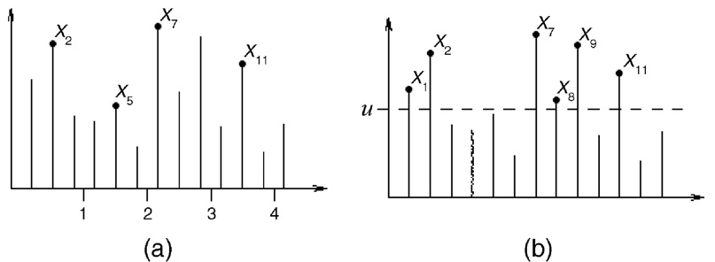
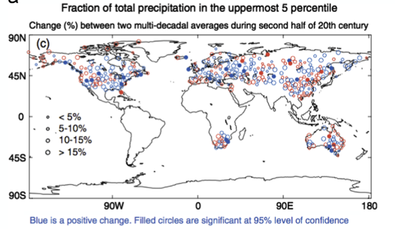
Extreme Event
Block Maxima Peak over Threshold
The IPCC Special Report on Managing the Risks of Extreme Events and Disasters to Advance Climate Change Adaptation gives a definition, stating that “an extreme (weather of climate) event is generally defined as the occurrence of a value of a weather or climate variable above (or below) a threshold value near the upper (or lower) ends of the range of observed values of the variable”.
Extreme events: very heavy rainfall, flood, draught, heat wave, Cold wave. Tornado, Cyclones.
Notes:
Importance : extreme has effects on different fields like agriculture, health water resources hence most important

Slide 4
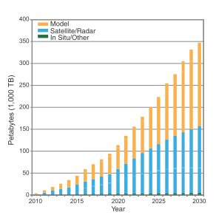
CLIMATE DATA EXPLODATION
The volume of worldwide climate data is expanding rapidly
creating challenges for both physical archiving and sharing, as well as for ease of access and finding what ’s needed, particularly if you are not a climate scientist.
The figure shows the projected increase in global climate data holdings for climate models, remotely sensed data, and in situ instrumental/proxy data

Slide 5
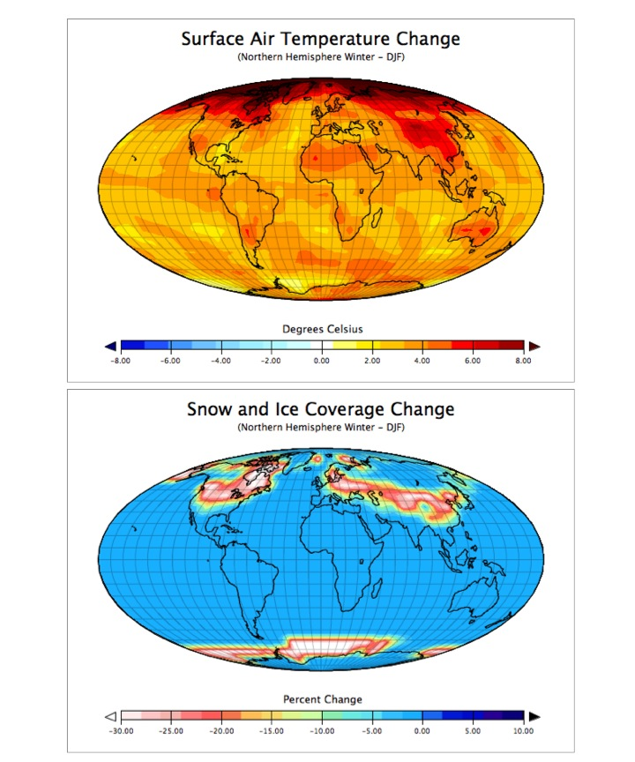
Grand Challenge on Extremes
Are existing observations sufficient to underpin the assessment of extremes?
What are the relative roles of large-scale, regional and local scale processes, as well as their interactions, for the formation of extremes?
Are models able to reliably simulate extremes and their changes, and how can this be evaluated and improved?
What are the contributors to observed extreme events and to changes in the frequency and intensity of the observed extremes?

Slide 6
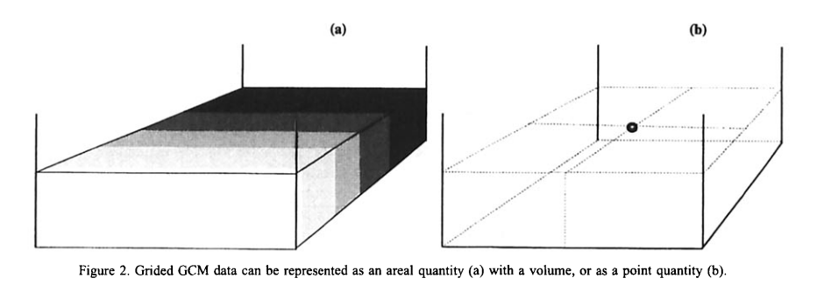
GRID BOX OR GRID POINT:
Are GCM data point or areal quantities; how does this affect spatial interpolation; and, how should climate impacts researchers use and interpret subgrid scale GCM data?
that interpolation does not create new information, it only increases the spatial precision of the existing data and it does this at the cost of increasing uncertainty.
the larger the area represented by a GCM value the smoother the resulting climate surface is likely to be and the more different from a similarly constructed observed climate surface.

Slide 7
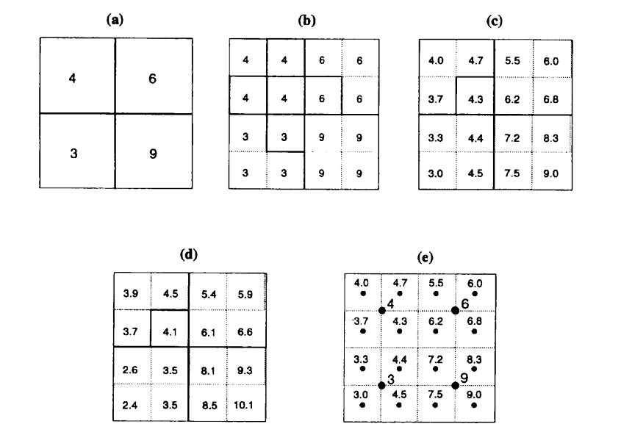
Simple Sub-gridding Values
superimpose desired finer resolution grid over the original grid and assign original values [Figure 4(a)] to the underlying finer grid [Figure 4(b)];
Recalculate each assigned value in the new grid using the average of its contiguous neighbouring cells; e.g. subgrid cell 4(2,2) is replaced with the average, 4.3, of its four neighbours (4, 4, 6, 3) [Figure (b and c)];
a ratio of 0.96 is obtained by dividing the sum of the original subgrid boxes, 16 [Figure (b)], by the sum of the new subgrid boxes, 16.7 [Figure (c)]. Each of the new subgrid boxes is multiplied by this ratio to preserve the original “volume” [Figure (d)].
Notes:
Method explained is right but grid box value given here are wrong. We have calculated.

Slide 8
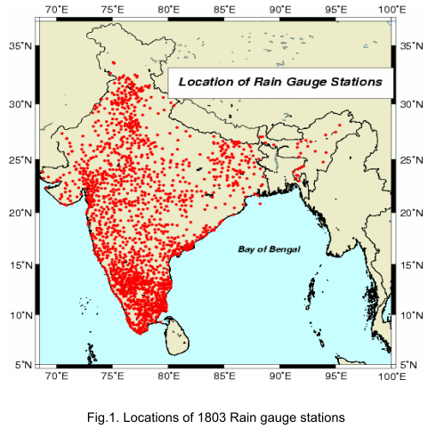
IMD GRID
“Development Of A High Resolution Daily Gridded Rainfall Data For The Indian Region” from station data by IMD.
rainfall data for the period 1951-2003
The density of stations is not uniform throughout the country.
Density is the highest over south Peninsula and is very poor over northern plains of India (Uttar Pradesh) and eastern parts of central India.

Slide 9
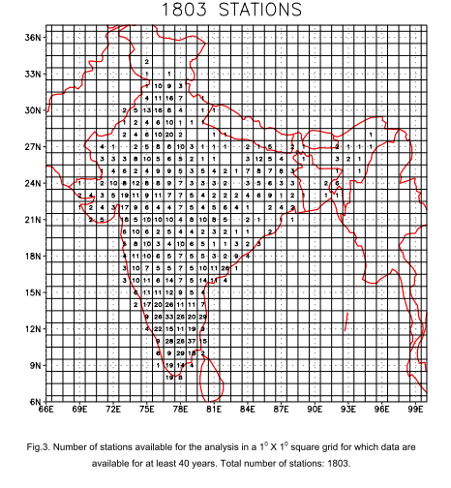
the mean number of stations (averaged for the period 1951-2003) available for the analysis in a 1⁰ X 1 ⁰ square grid. Number of stations per grid (station density) is very large over south Peninsula.
Angular distance weighting, the interpolation scheme proposed by Shepard (1968) was used.

Slide 10
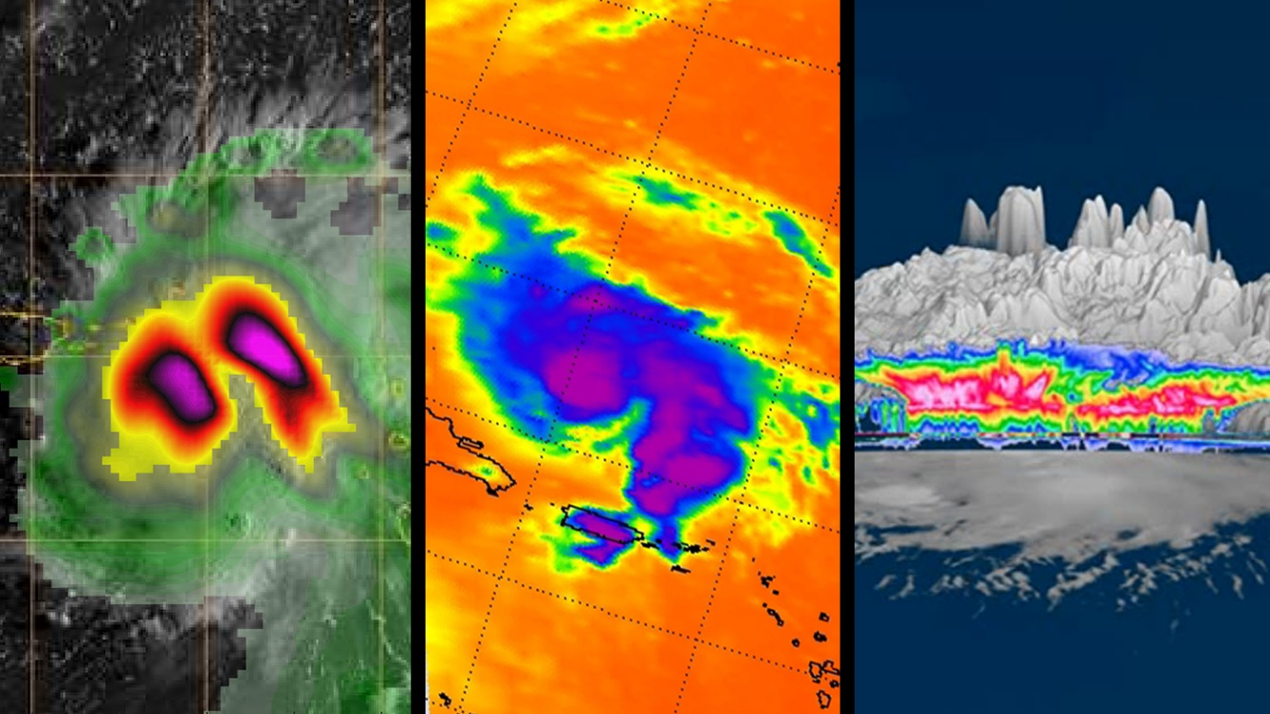
Problem due to interpolation
In particular, when using gridded data extreme events will be missed in most of the occasions due to interpolation or averaging scheme used in gridding. This can then give misleading information regarding the signals of hydrological extremes needed for better disaster management.

Slide 11
Commonly used interpolations in the development of climate datasets.
natural neighbor (Sibson1981)
cubic spline (Hutchinson, 1995; Jones et al., 2009)
angular distance weighting (Shepard, 1968)

Slide 12
Other Spatial Interpolations
Inverse Distance Weighting (IDW)
Triangulation with Linear Interpolation (TLI)
Ordinary Kriging (OK)
Natural Neighbour Interpolation (NNI)
Barnes Objective Analysis (BOA)

Slide 13
How the horizontal resolution, interpolation method and order of operation in generating gridded data sets affect estimates of annual extreme indices
Three interpolation methods (natural neighbors, cubic spline and angular distance weighting) are used to calculate grids at ﬁve different horizontal gridded resolutions ranging from 0.25°x0.25°, 0.5°x0.5°, 1.0°x1.0°, 1.5°x1.5° and 2.5° x 2.5°
either they are estimated from daily grids or from station points and then gridded. The grid resolution -despite showing more regional detail at high resolution has relatively limited effect when considering regional averages.
the interpolation method and the order of operation can substantially inﬂuence the actual gridded values. And while the difference due to the order of operation is not substantial when using natural neighbor and cubic spline interpolation, it is particularly apparent for indices calculated from daily gridded estimates using the angular distance weighting method.

Slide 14
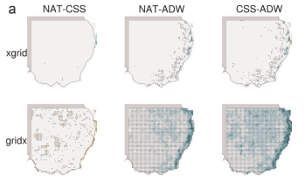
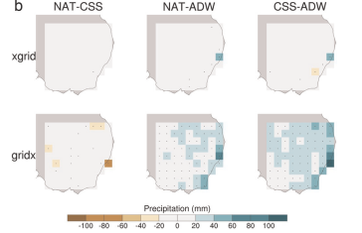
Difference between interpolation methods for Rx1 day (averaged over the period 1961–1990)
Grid size 0.25°x0.25°
Grid size 1.5°x1.5°
interpolation methods
interpolation methods
Grid of annual
extreme
Extreme from daily grid
Notes:
Difference between interpolation methods for Rx1 day (averaged over the per-
iod 1961–1990) at horizontal resolutions (a) 0.25°x0.25° and (b) 1.5°x1.5°. Columns
indicate the interpolation methods being compared: NAT-CSS (left), NAT-ADW
(center) and CSS-ADW (right). Rows indicate the gridding approach: grid of annual
extreme (xgrid, top) and extreme from daily grid (gridx, bottom). Black dot markers
indicate signiﬁcant difference (pr0.1; Student's t-test).

Slide 15
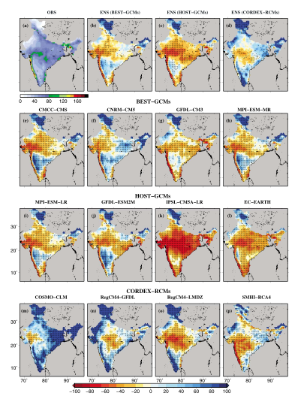
Reliability of regional and global climate models to simulate precipitation extremes over India
The inability of climate models to credibly project precipitation extremes in India has not been helpful to longer‐term hazards resilience policy. However, there have been claims that finer‐resolution and regional climate models may improve projections. The claims are examined as hypotheses by comparing models with observations from 1951–2005.
Observed trends in the extremes were not adequately captured by any of the model ensembles, while neither the GCMs nor the RCMs were determined to be adequate to inform hydrologic design.
Observed mean annual maximum precipitation (AMP) for the period of 1951 – 2005
Notes:
Figure 2. (a) Observed mean annual maximum precipitation (AMP) for the period of 1951 – 2005; (b – d) ensemble mean bias (%) in AMP in the BEST-GCMs (CMCC-CMS,
CNRM-CM5, GFDL-CM3, and MPI-ESM-MR), HOST-GCMs (MPI-ESM-LR, GFDL-ESM2M, IPSL-CM5A-LR, and EC-EARTH), and CORDEX-RCMs (COSMO-CLM, RegCM4-GFDL,
RegCM4-LMDZ, and SMHI-RCA4); and (e – p) bias for the individual models in the BEST-GCMs, HOST-GCMs, and CORDEX-RCMs. Bias (%) for the BEST-GCMs, HOST-GCMs,
and CORDEX-RCMs was estimated for the period of 1951 – 2005. Stippling shows grid cells where mean is signi ﬁ cantly different than observed mean as estimated by
the rank sum test. Stippling in Figures 2b – 2d shows grid cells where mean is signi ﬁ cantly different than observed mean in all the models in the BEST-GCMs, HOST-GCM,
and CORDEX-RCMs.
“ BEST-GCMs ” = selected based on their performance to simulate extreme precipitation over India.
HOST-GCMs = overall ability to simulate the Indian Monsoon and the large-scale atmospheric variables of the South Asian monsoon

Slide 16
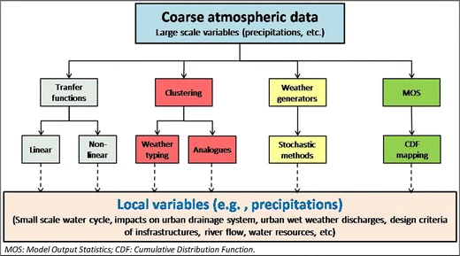
Solution: Down scaling or Finer Grid?
Notes:
Should we go with down scaling and bias correction with observed data (limitation: observed data should be available)
OR finer grid products should be available for end users who are working on the effects of extreme on different fields like agriculture, health water resources

Slide 17
References
1. Alexander, L. V. Global observed long-term changes in temperature and precipitation extremes: A review of progress and limitations in IPCC assessments and beyond. Weather Clim. Extrem. 11, 4–16 (2016).
2. Contractor, S., Alexander, L. V., Donat, M. G. & Herold, N. How Well Do Gridded Datasets of Observed Daily Precipitation Compare over Australia? Adv. Meteorol. 2015, (2015).
3. Gooré Bi, E., Gachon, P., Vrac, M. & Monette, F. Which downscaled rainfall data for climate change impact studies in urban areas? Review of current approaches and trends. Theor. Appl. Climatol. 127, 685–699 (2017).
4. Menon, Preetha and Mazumdar, Sreejith, and P. G. Changes in extreme rainfall events and flood risk in India during the last century. (2010).
5. Rajeevan, M., Bhate, J., Kale, J. D. & Lal, B. Development of a High Resolution Daily Gridded Rainfall Data. IMD - Met. Monogr. Climatol. No. 22/2005 Dev. 1–26 (2005).

Slide 18
References
6. Seneviratne, S. I. & Zwiers, F. W. Attribution and prediction of extreme events: Editorial on the special issue. Weather Clim. Extrem. 9, 2–5 (2015).
7. Skelly, W. C. & Henderson-Sellers, A. Grid box or grid point: What type of data do GCMs deliver to climate impacts researchers? Int. J. Climatol. 16, 1079–1086 (1996).
8. Mishra, Vimal and Kumar, Devashish and Ganguly, Auroop R and Sanjay, J and Mujumdar, Milind and Krishnan, R and Shah, R. D. Reliability of regional and global climate models to simulate precipitation extremes over India. J. Geophys. Res. Ocean. 3909–3925 (2014) doi:10.1002/2014JD021636.Received.
9. Avila, F. B. et al. Systematic investigation of gridding-related scaling effects on annual statistics of daily temperature and precipitation maxima: A case study for south-east Australia. Weather Clim. Extrem. 9, 6–16 (2015).
10. Easterling, D. R. et al. Climate Data Challenges in the 21st Century in the 21st Century. Small 41, 229–246 (2004).

Slide 19

THANK YOU
ORCID profile
ssmujumdar-ced@msubaroda.ac.in

