Slide 1
To Predict The Electromagnetic Interference Shielding Effectiveness Of Textile Composite Material
Mr. Dinesh Chudasama Dr. Satyajeet Chaudhari
Department of Textile Engineering
Faculty of technology and Engineering
The Maharaja Sayajirao University of Baroda

Slide 2
1. Introduction
The trend in today’s electronic devices is more faster.
Any electrical or electronic apparatus such as high voltage power lines, radar, communication system, radios, televisions, household appliances, computer, mobile phones etc generates electromagnetic waves, that are produced when an electric field comes in contact with the magnetic field.

Slide 3
Today’s high-tech electronic gadgets, not only bring us convenience but also many negative effects.
These electromagnetic waves create electromagnetic interference to the electrical circuits and also adversely affect human health after prolong exposure.

Slide 4
When electromagnetic waves enter the human body, it will destruct cell’s regeneration of DNA and RNA.
Furthermore, it causes cancer, brain tumor, heart attack and skin diseases etc.

Slide 5
Electromagnetic Interference is encountered by all of us in our daily life and are expected to face exponential rise in future due to the growing number of wireless devices and standards including cell phones, GPS, Bluetooth, WIFI, etc.

Slide 6
Electromagnetic Interference (EMI) is the disturbance that affects the working of an electrical circuit due to either electromagnetic induction or electromagnetic radiation emitted from an external source.
This disturbance may interrupt, obstruct or degrade the effective performance of circuit.

Slide 7
What is EMI….???
When electromagnetic energy from sources external or internal to electrical or electronic equipment affects that equipment adversely by causing it to have undesirable responses, such as degraded performance or malfunctions, the electromagnetic energy is called electromagnetic interference ( EMI)

Slide 8
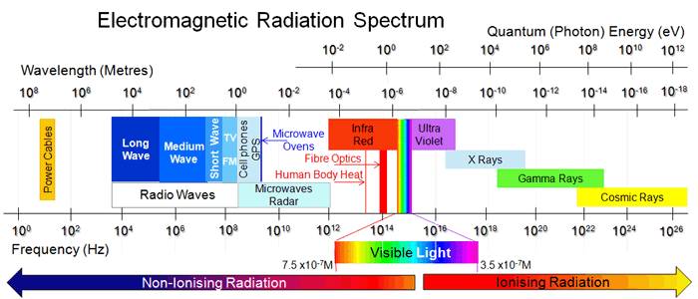

Slide 9
When low power levels are used in either of these circuits, they become more susceptible to interference from external electromagnetic fields.
The interference can cause erroneous data, unwanted results, false alarms, or even complete shutdown of the instrument. The effects can be totally unpredictable. Adequate electromagnetic protection is being recognized as a critical element in design of low power equipment.

Slide 10
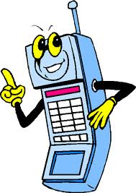

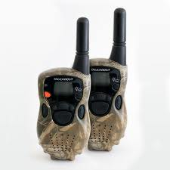
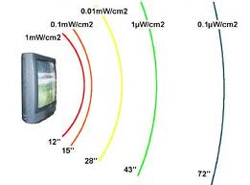
SOURCE OF EMI & frequency
garage door openers,
cellular phones
television (TV) stations,
walkie talkies

Slide 11
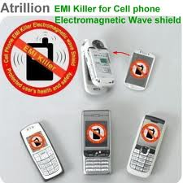

Slide 12
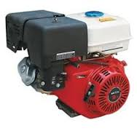
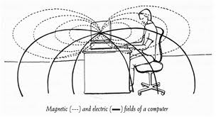
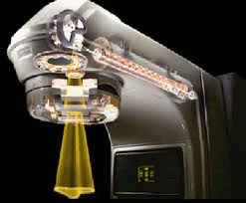
medical equipment
ignition systems of gasoline engines
computer systems

Slide 13
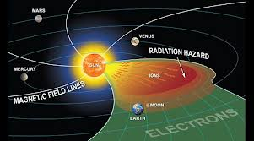
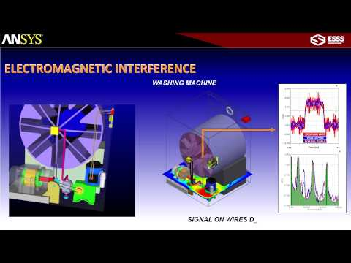
Even the sun produces radio frequency electromagnetic radiation.

Slide 14
AM radio | 535 kilohertz to 1.7 megahertz
Short wave radio | 5.9 megahertz to 26.1 megahertz
Citizens band (CB) radio | 26.96 megahertz to 27.41 megahertz
Television stations, channels 2 through 6 | 54 to 88megahertz
FM radio | 88 megahertz to 108 megahertz
Television stations, channels 7 through 13 | 174 to 220 megahertz

Slide 15
Some Wireless Technology Bands
Garage door openers, alarm systems Around 40 MHZ Standard cordless phones 40 to 50 MHz
Baby monitors 49 MHz Radio controlled air plains Around 72 MHz
Radio controlled cars Around 75 MHz
Wildlife tracking collars 215 to 220MHz MIR space station 145 to 437 MHz
Cell phones 824 to 849 MHz cordless phones 900 MHz
Air traffic control radar 960 to 1,215 MHz Global Positioning System 1,227 and 1,575 MHz Deep space radio communications 2,290 MHz to300MHz

Slide 16
Protection Method:
The simplest way of protection from electromagnetic waves is to stay away from it but this is not always possible in real life.
The most effective method of protection from electromagnetic waves is the use of shielding or electromagnetic shielding material.

Slide 17
Electromagnetic shielding is a conductive barrier that completely envelops an electronic device to protect from environmental interference or to stop emission from the device itself interfering with other devices.
In other words, electromagnetic shielding is the practice of reducing the electromagnetic field in a space by blocking the field with barriers made of conductive or magnetic materials.

Slide 18
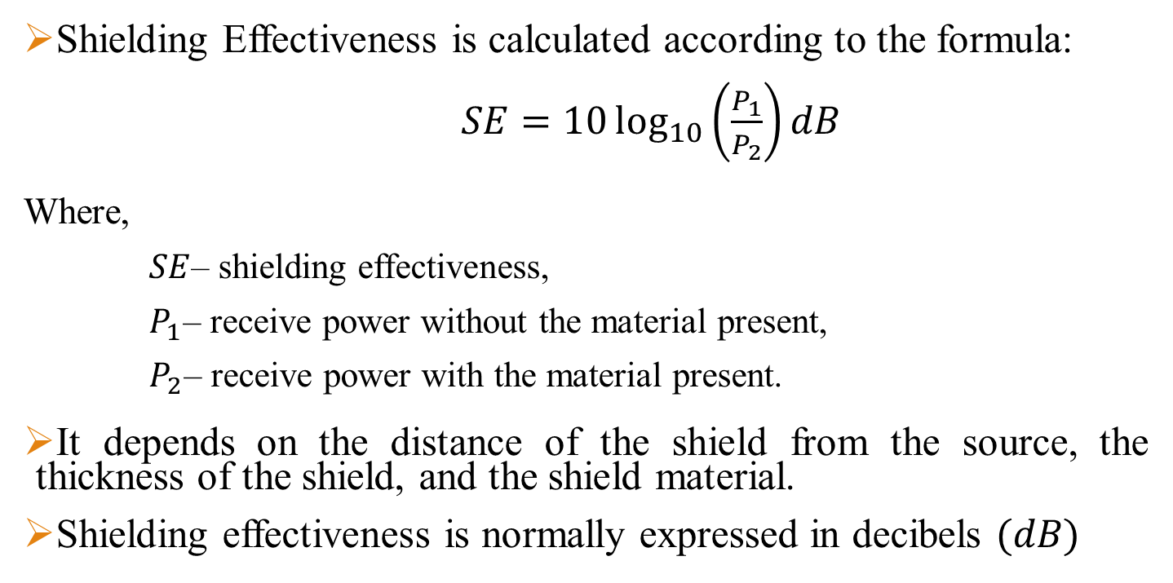
SHIELDING EFFECTIVENESS

Slide 19
Testing method
In 1989, on the basis of a report from the NBS, the American Society for Testing and Materials (ASTM) developed and issued the D4935 standard .
In this method, the test adapter is constructed using a section of 50 Ω coaxial aerial, having a external-to-internal diameter ratio of 76 to 33 mm (Figure 5). The shielding effectiveness measurements are carried out for frequencies ranging from 30 MHz to 1.5 GHz. In practice, measurements starting from about 1 MHz would be possible,
that of the network analyser used for these measurements. For frequencies above 1.5 GHz,

Slide 20
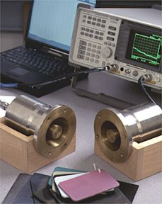
Network Analyzer
Transmitter
Receiver

Slide 21
Motivated by the increase of stress over electromagnetic pollution issues arising from the fast-growing development and need for electronic and electrical devices, the demand for material with high electromagnetic interference shielding performance has become more urgently.

Slide 22
The common material used for construction of enclosure for shielding is metal such as copper, brass, aluminium, silver, nickel, stainless steel etc.
Although such material has good shielding performance but it has some disadvantages like low elasticity, heavy weight, high costs, easy to corrode etc.

Slide 23
So, there was a need of material which is light weighted, flexible, corrosion resistant and cheap.
Textile material fulfils all these requirements.
But textile materials are electrically nonconductive. So, it was necessary to make it electrically conductive.

Slide 24
These are various methods available for imparting electrical properties to textile material such as magnetron sputtering, coating of fabric with metal, incorporating conductive fibres or yarns in fabric etc.

Slide 25
In our experiment, a commercially available polyester-cotton(PC) blended fabric is chosen and to make the fabric electrically conductive, its surface is coated with silver metal using magnetron sputtering technique.

Slide 26
Three different PC blended fabric samples was coated with 1, 3, and 5 micro meter thickness of silver to make fabric electrically conductive and then they were tested as per the ASTM D4935 method for electromagnetic interference shielding effectiveness test.

Slide 27
From the experiment it was observed that shielding effectiveness increases by increasing the thickness of silver coating.

Slide 28
Performing the experiment every time, to know electromagnetic interference shielding effectiveness of given material, will be costly and time-consuming process. So, mathematical model and simulation will avoid the actual experimentation and helps in designing the more suitable material in faster way.

Slide 29
Problem defination
Therefore, our objective is
To Develop The Model To Predict Electromagnetic Shielding Effectiveness.

Slide 30


