Slide 1
Developing an Isothermal Testing Chamber Facility
Electrical Research and Development Association, India

Slide 2
INTRODUCTION
ERDA (Electrical Research & Development Association) is one of the most modern centers for Research & Development, Certification & Calibration of electrical products since1974 in Vadodara at Makarpura Industrial Estate.
ERDA is credited recognized as ISO-17025 certified laboratory. It equipped with the advance infrastructure to meet National and International standards. It has 5000 domestic as well as international customers every year.
ERDA operates premium laboratory for switch gears and control gears. Its laboratory has country’s largest IP Test facility.
ERDA has also three laboratory sites across India, ERDA(North) at Gurgaon,ERDA(West) at Rabale, and ERDA(South) at Rajamundry to serve the customers across various geographical locations of India.
ERDA’s R&D division has developed, improved, and commercialized several award-winning technologies like On-line Fault Sensor, DCMCB, Fault Current-meter, LED based manual rechargeable Lamp & new Polymeric material for wiring accessories with a respectable IPR portfolio.
Since the ambient temperature in the Gulf region is high the testing facility is recommended to be designed at an ambient temperature of 55°C.
ERDA has developed the temperature controlled chamber to meet the above requirement at ERDA ,
makarpura .

Slide 3
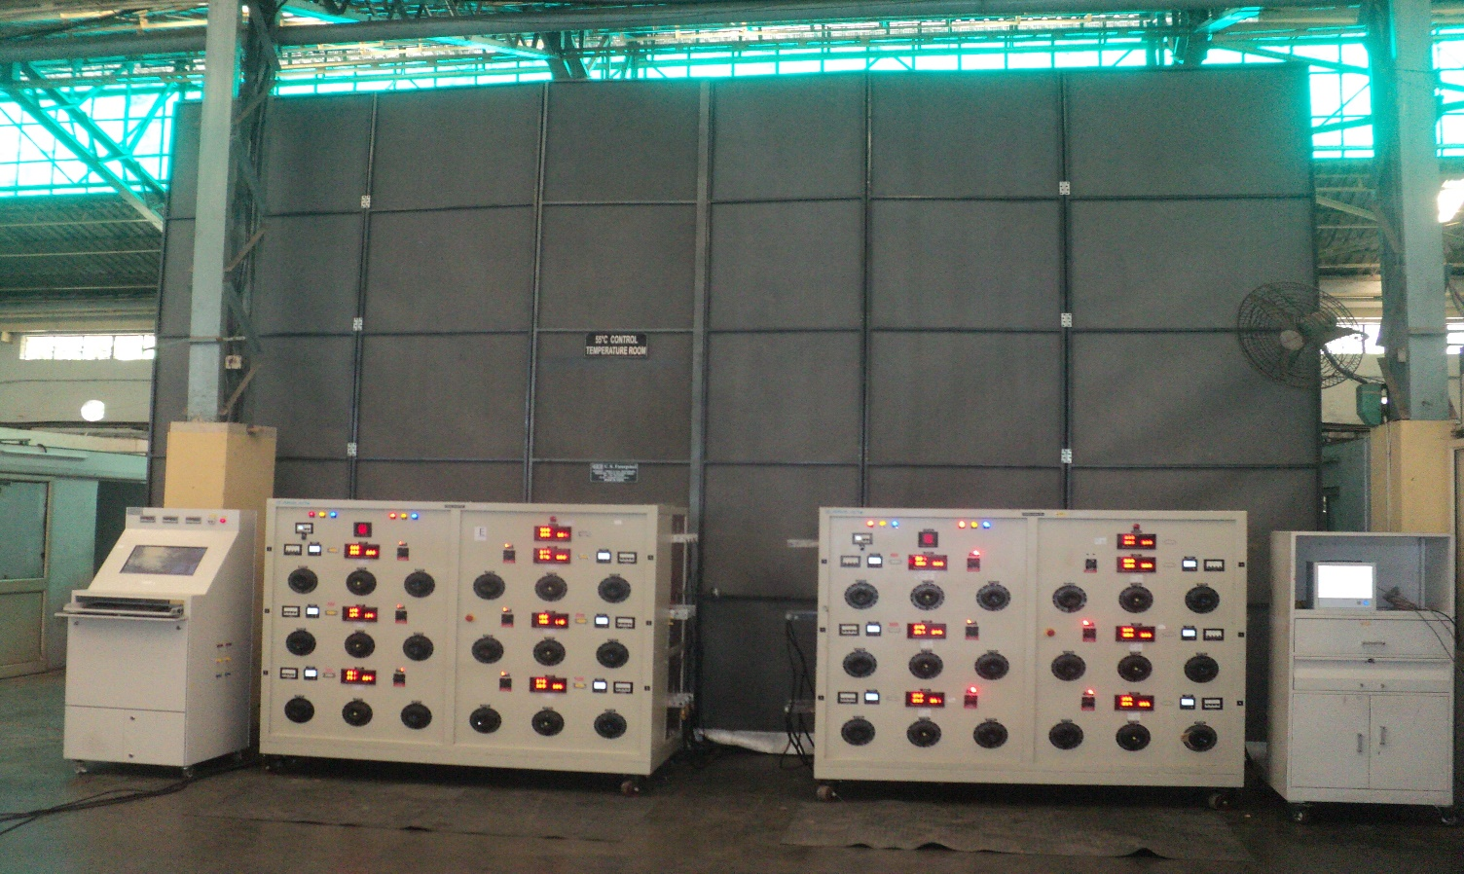
Dimensions of the chamber:
Width- 7.0 m
Depth - 5.5 m
Height - 5.0 m

Slide 4
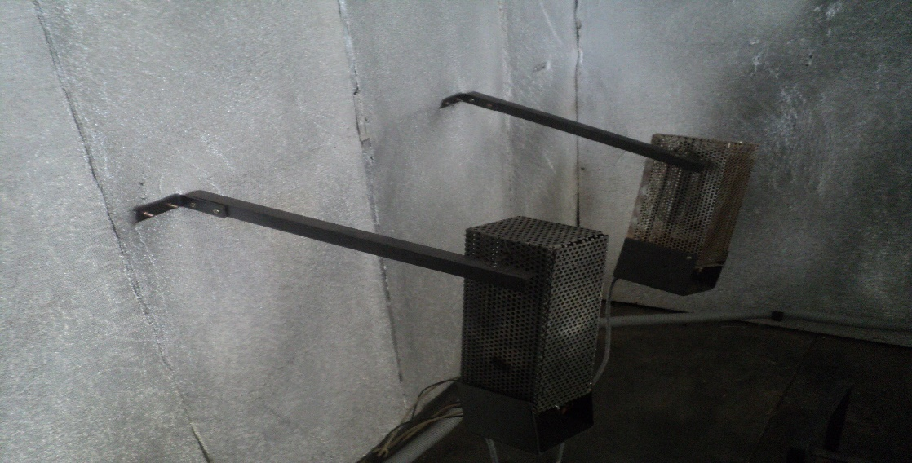
Heating System:
Stainless steel finned type heaters shall be used to achieve the temperature.
Positioning of the heater shall be such that there is no direct radiation from the heater on the test specimen.

Slide 5
Requirement of chamber:
No exchange of air entering or leaving the Test Chamber is allowed. That is the Test Chamber is like an air tight furnace arrangement.
The Test Chamber should be collapsible and self-supported.
Temperature inside the chamber may be maintained by auxiliary heating arrangement. A suitable control panel must be designed with protection system for individual control of the heating arrangements.
Ambient temp. inside the chamber should be maintained up to +55°C.
No temperature difference within the chamber of more than 2°C.
Uniformity of the temperature inside the chamber shall be measured and verified by 9-point measurement method using thermocouple.

Slide 6
Challenge faced by ERDA:
Due to heating in closed chamber, there is air draft created and due to this there is change in temperature. How to estimate this change in temperature due to air draft.

Slide 7

THANK YOU

